Slide 1
CONVOLUTION NEURAL NETWORK
BY
VJ AND SANGO

Slide 2
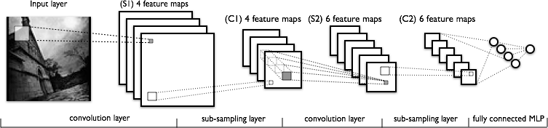
ARCHITECTURE OF CONVOLUTION NEURAL NETWORK

Slide 3
Pixel's intensity as the value for a corresponding neuron in the input layer.
28×28 pixel images has 784(=28×28) input neurons. We then trained the network's weights and biases so that the network's output would - we hope! - correctly identify the input image: '0', '1', '2', ..., '8', or '9'.
CNN helps us train deep, many-layer networks, which are very good at classifying images. Today, deep convolutional networks or some close variant are used in most neural networks for image recognition.

Slide 4
OPERATIONS INVOLVED IN CNN
Convolutional neural networks use three basic ideas:
local receptive fields,
shared weights, and
pooling.

Slide 5
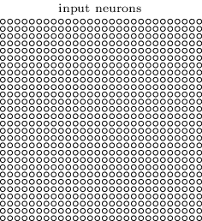
Local receptive fields: In the fully-connected layers shown earlier, the inputs were depicted as a vertical line of neurons. In a convolutional net, it'll help to think instead of the inputs as a 28×28 square of neurons, whose values correspond to the 28×28pixel intensities we're using as inputs:

Slide 6
Connect the input pixels to a layer of hidden neurons. But we won't connect every input pixel to every hidden neuron. Instead, we only make connections in small, localized regions of the input image.
Each neuron in the first hidden layer will be connected to a small region of the input neurons, say, for example, a 5×5 region, corresponding to 25 input pixels. So, for a particular hidden neuron, we might have connections that look like this:

Slide 7
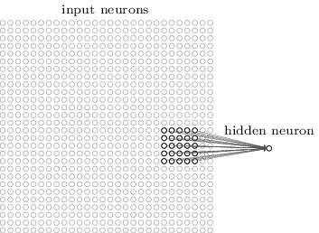
LOCAL RECEPTIVE FIELD
That region in the input image is called the local receptive field for the hidden neuron.

Slide 8
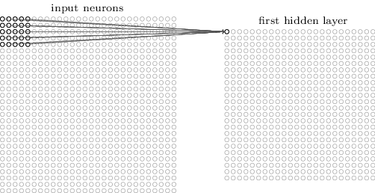
We then slide the local receptive field across the entire input image. For each local receptive field, there is a different hidden neuron in the first hidden layer
A local receptive field in the top-left corner:

Slide 9
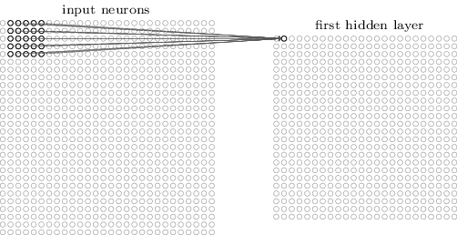
Slide the local receptive field over by one pixel to the right (i.e., by one neuron), to connect to a second hidden neuron:
And so on, building up the first hidden layer. Note that if we have a 28×28 input image, and 5×5 local receptive fields, then there will be 24×24 neurons in the hidden layer. This is because we can only move the local receptive field 23x23 neurons across (or 23x23 neurons down), before colliding with the right-hand side (or bottom) of the input image.

Slide 10
SHARED WEIGHTS AND BIASES
Shared weights and biases: I've said that each hidden neuron has a bias and 5×5 weights connected to its local receptive field. What I did not yet mention is that we're going to use the same weights and bias for each of the 24×24hidden neurons
σ is the neural activation function - perhaps the sigmoid function we used in earlier chapters. b is the shared value for the bias.

Slide 11
all the neurons in the first hidden layer detect exactly the same feature. just at different locations in the input image.
To see why this makes sense, suppose the weights and bias are such that the hidden neuron can pick out, say, a vertical edge in a particular local receptive field. That ability is also likely to be useful at other places in the image. And so it is useful to apply the same feature detector everywhere in the image. To put it in slightly more abstract terms, convolutional networks are well adapted to the translation invariance of images: move a picture of a cat (say) a little ways, and it's still an image of a cat*

Slide 12
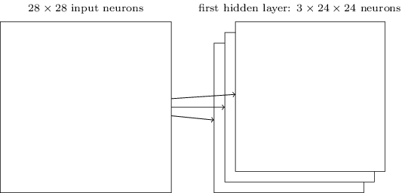
we sometimes call the map from the input layer to the hidden layer a feature map. We call the weights defining the feature map the shared weights. And we call the bias defining the feature map in this way the shared bias. The shared weights and bias are often said define a kernel or filter.

Slide 13
A big advantage of sharing weights and biases is that it greatly reduces the number of parameters involved in a convolutional network.
For each feature map we need 25=5×5 shared weights, plus a single shared bias. So each feature map requires 26parameters.
If we have 20 feature maps that's a total of 20×26=520 parameters defining the convolutional layer.
By comparison, suppose we had a fully connected first layer, with 784=28×28 input neurons, and a relatively modest 30 hidden neurons,. That's a total of 784×30 weights, plus an extra 30 biases, for a total of 23,550parameters.
In other words, the fully-connected layer would have more than 40 times as many parameters as the convolutional layer.
That, in turn, will result in faster training for the convolutional model, and, ultimately, will help us build deep networks using convolutional layers.

Slide 14
POOLING LAYERS
Pooling layers: In addition to the convolutional layers just described, convolutional neural networks also contain pooling layers. Pooling layers are usually used immediately after convolutional layers. What the pooling layers do is simplify the information in the output from the convolutional layer.
A pooling layer takes each feature map.
Output from the convolutional layer and prepares a condensed feature map. For instance, each unit in the pooling layer may summarize a region of (say) 2×2neurons in the previous layer.
one common procedure for pooling is known as max-pooling. In max-pooling, a pooling unit simply outputs the maximum activation in the 2×2 input region

Slide 15
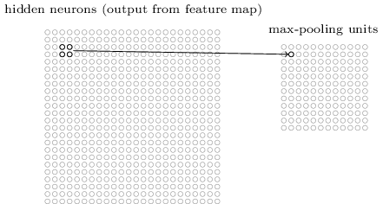
since we have 24×24 neurons output from the convolutional layer, after pooling we have 12×12neurons

Slide 16
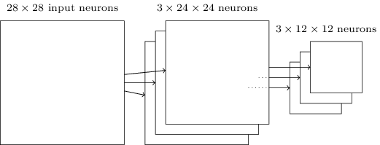
The convolutional layer usually involves more than a single feature map. We apply max-pooling to each feature map separately. So if there were three feature maps, the combined convolutional and max-pooling layers would look like:

Slide 17
We can think of max-pooling as a way for the network to ask whether a given feature is found anywhere in a region of the image. It then throws away the exact positional information. The intuition is that once a feature has been found, its exact location isn't as important as its rough location relative to other features. A big benefit is that there are many fewer pooled features, and so this helps reduce the number of parameters needed in later layers.
Max-pooling isn't the only technique used for pooling. Another common approach is known as L2 pooling. Here, instead of taking the maximum activation of a 2×2 region of neurons, we take the square root of the sum of the squares of the activations in the 2×22×2region.
While the details are different, the intuition is similar to max-pooling: L2 pooling is a way of condensing information from the convolutional layer. In practice, both techniques have been widely used. And sometimes people use other types of pooling operation.

Slide 18
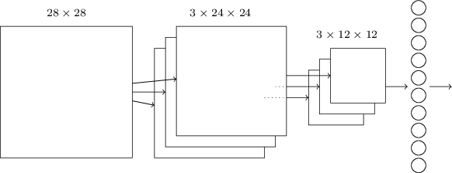
SUMMARISING THE ARCHITECTURE
It's similar to the architecture we were just looking at, but has the addition of a layer of 10 output neurons, corresponding to the 10 possible values for MNIST digits ('0', '1', '2', etc):

Slide 19
The network begins with 28×28 input neurons, which are used to encode the pixel intensities for the MNIST image.
This is then followed by a convolutional layer using a 5×5 local receptive field and 3 feature maps. The result is a layer of 3×24×24 hidden feature neurons. The next step is a max-pooling layer, applied to 2×2 regions, across each of the 3 feature maps. The result is a layer of 3×12×12 hidden feature neurons.
The final layer of connections in the network is a fully-connected layer. That is, this layer connects every neuron from the max-pooled layer to every one of the 10 output neurons.

Slide 20
EFFICIENCY
CLASSIFIED AROUND 9000 MNIST IMAGES IN 10000 IMAGES AND THE EFFICIENCY WAS INCREASED WHEN WE USE IT FOR FACE RECOGNITION
TESTED 100 IMAGES OF DIFFERENT STUDENTS WITH 6 TRAINING IMAGES AND 2 TEST IMAGES GAVE A EFFICIENCY OF NEARLY 100%

Slide 21
CONCLUSION
CNN is best suited for face recognition compared with the other algorithms
REFERENCE:
http://neuralnetworksanddeeplearning.com/chap6.html

